Slide 1
Laser Arcade Project
Spring 2025
Presented By: Alex Wheelock & Andrew Keller

Slide 2
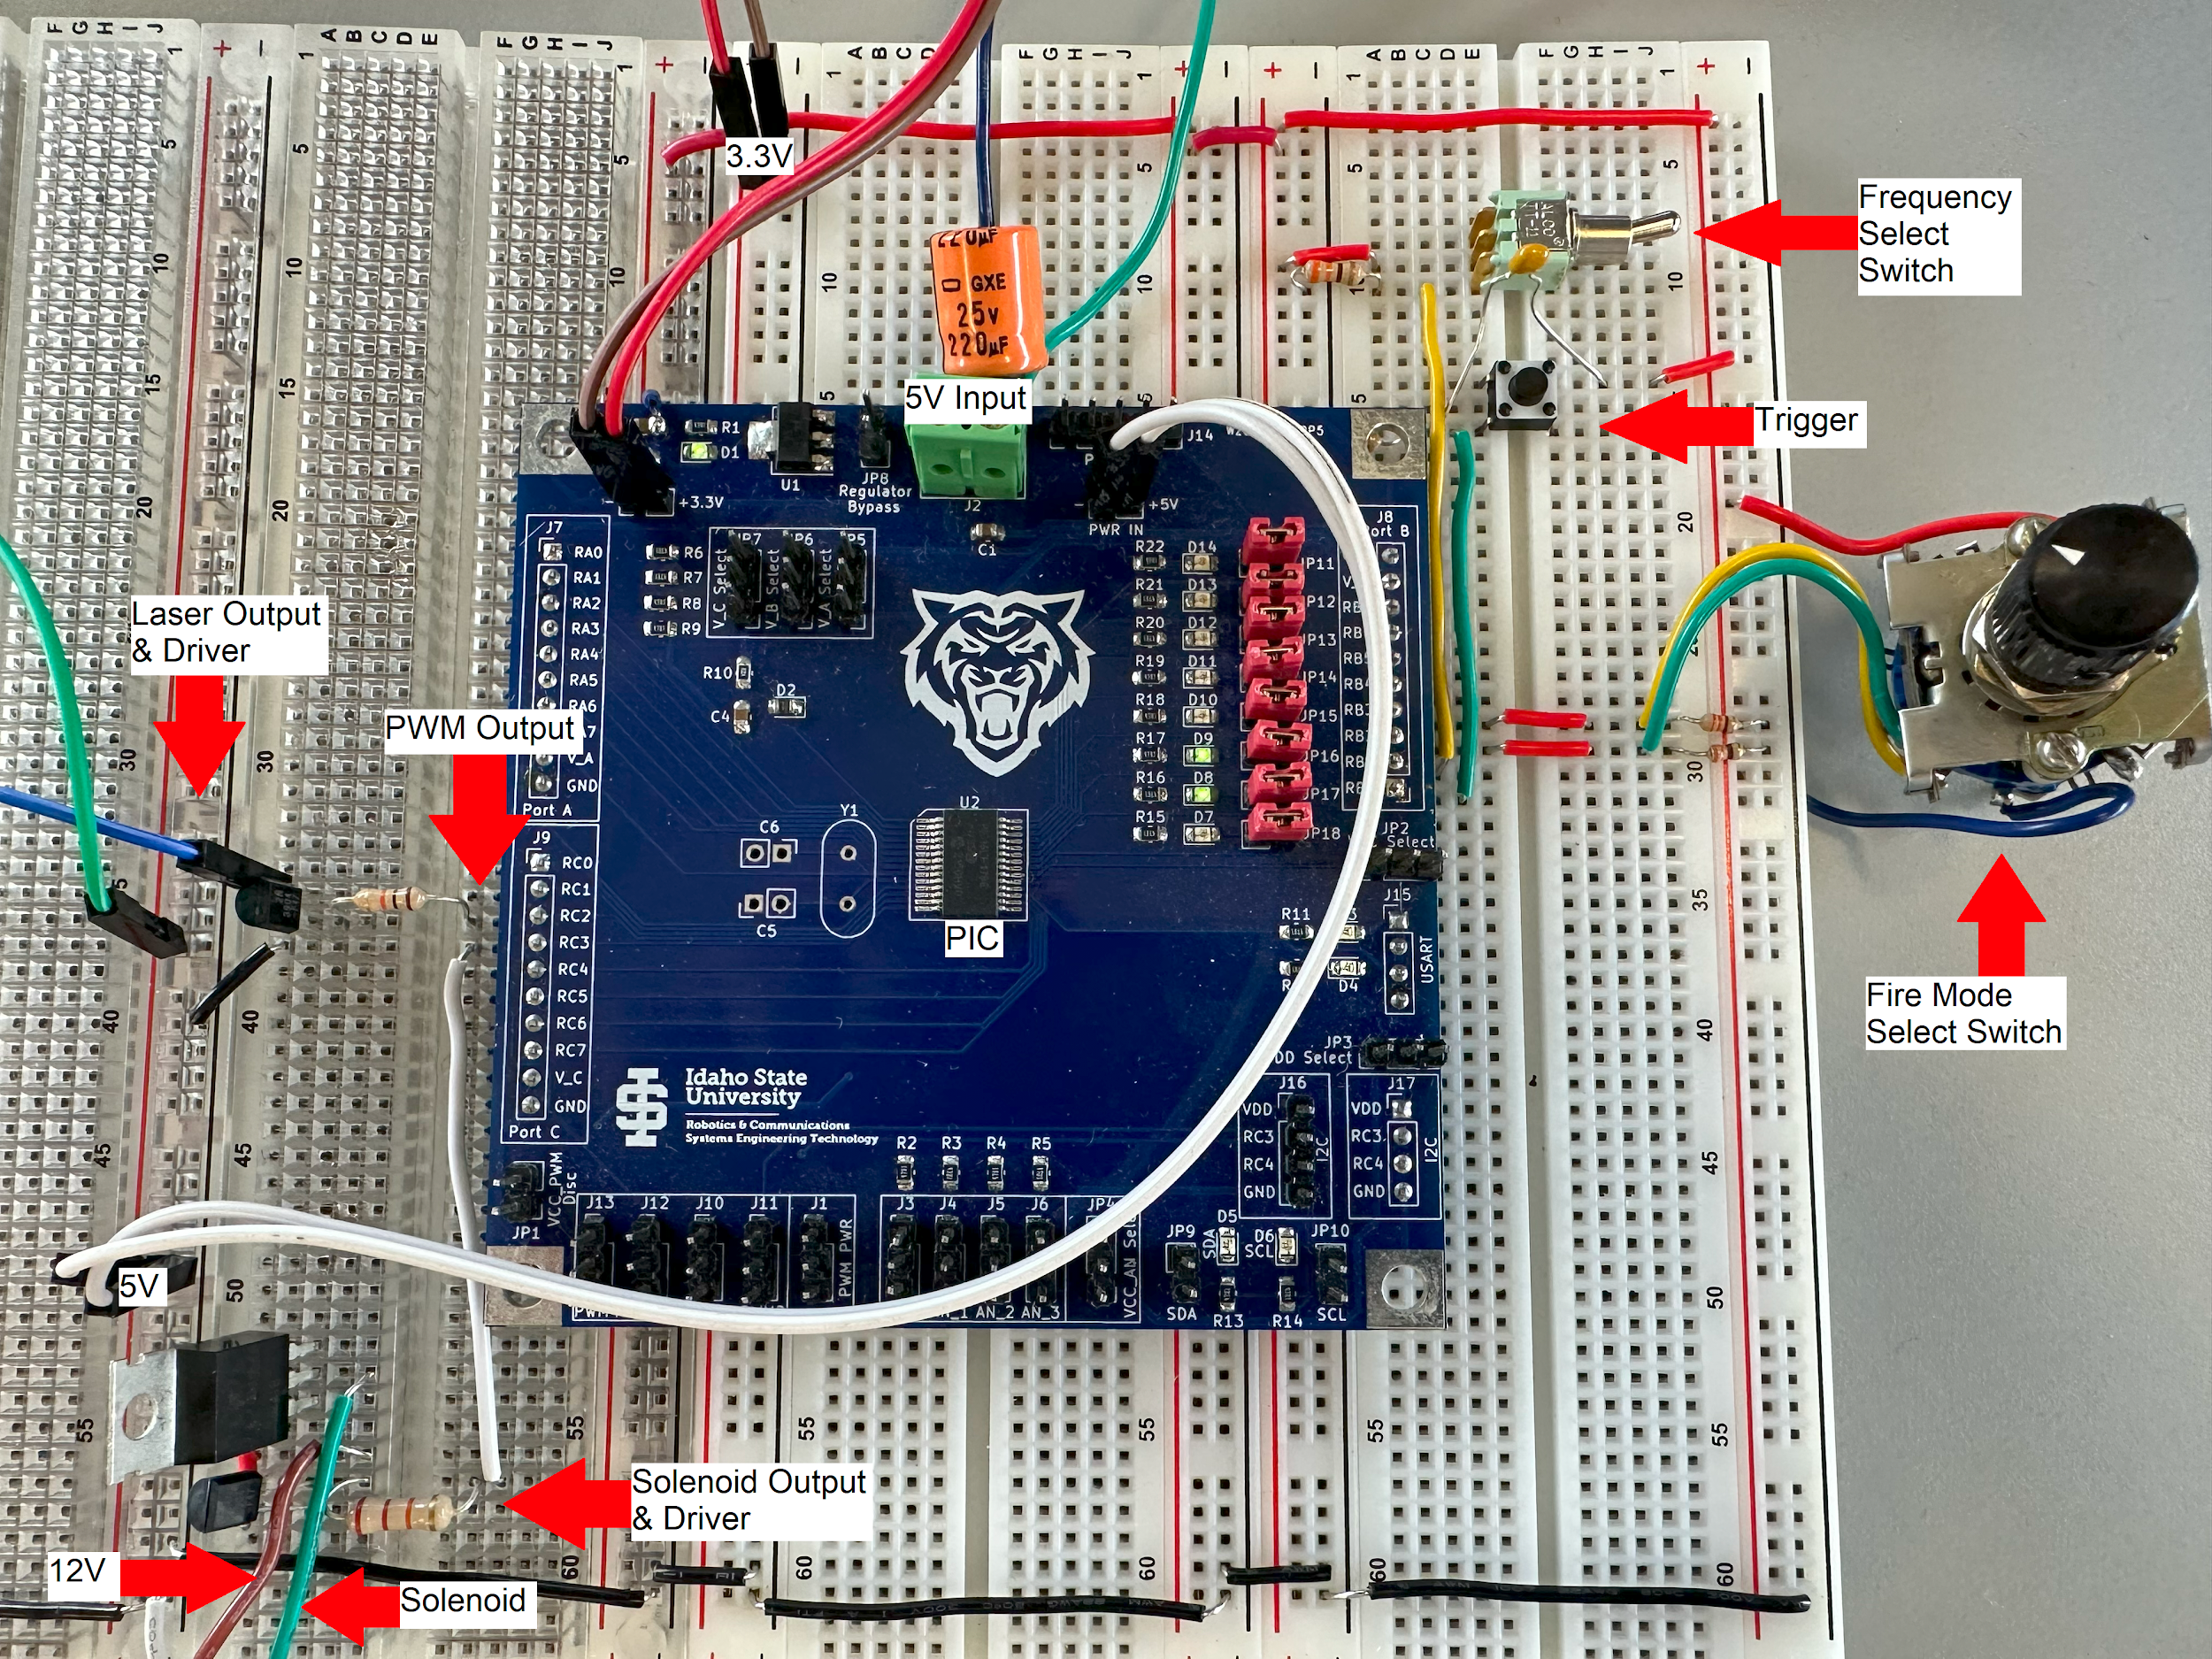
Previous Work
Laser Arcade project started in the Fall 2024 semester.
Project idea was laid out.
A functional blaster was designed and built on a breadboard.
Very little work done on the target system.
Credit: Alex Wheelock, Fall 2024

Slide 3
Semester Goals
Finalize all schematics, and design PCBs.
Complete the target system
Finish programming master and slaves.
Write a VB program to control/run the game.
Design a target/reflector that allows both IR sensors to detect the laser.
Complete the blaster
Add an audio output to the blaster.
Modify a Nerf gun to house the internals of the blaster.

Slide 4
Blaster Updates
Blaster is now wired to a 12V DC power supply.
A regulator supplies PIC and laser with 5V.
Added an optional laser output for an IR laser if needed.
Added an audio board and speaker.
Designed a PCB.
All electronics now housed in a modified Nerf gun.

Slide 5
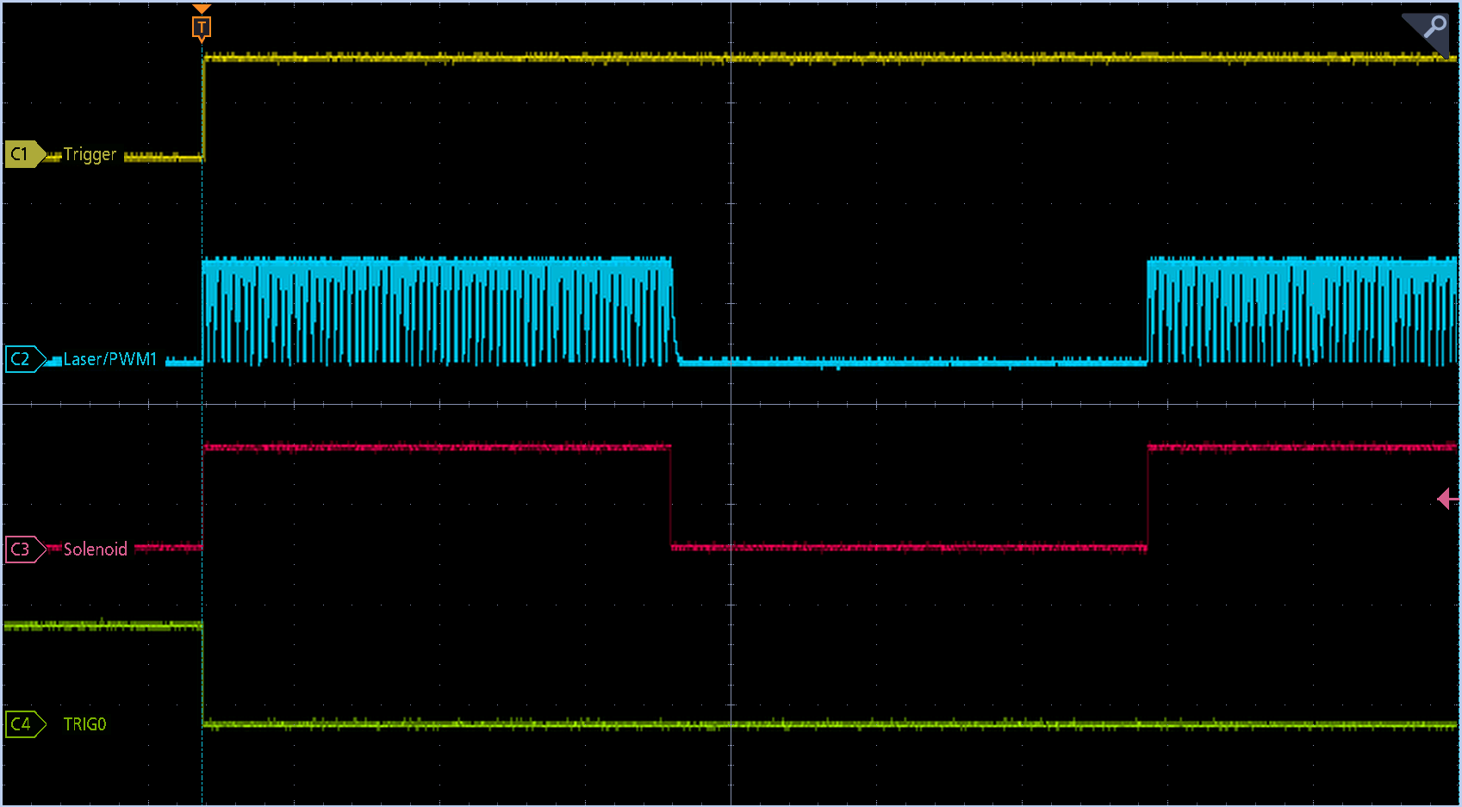

Slide 6
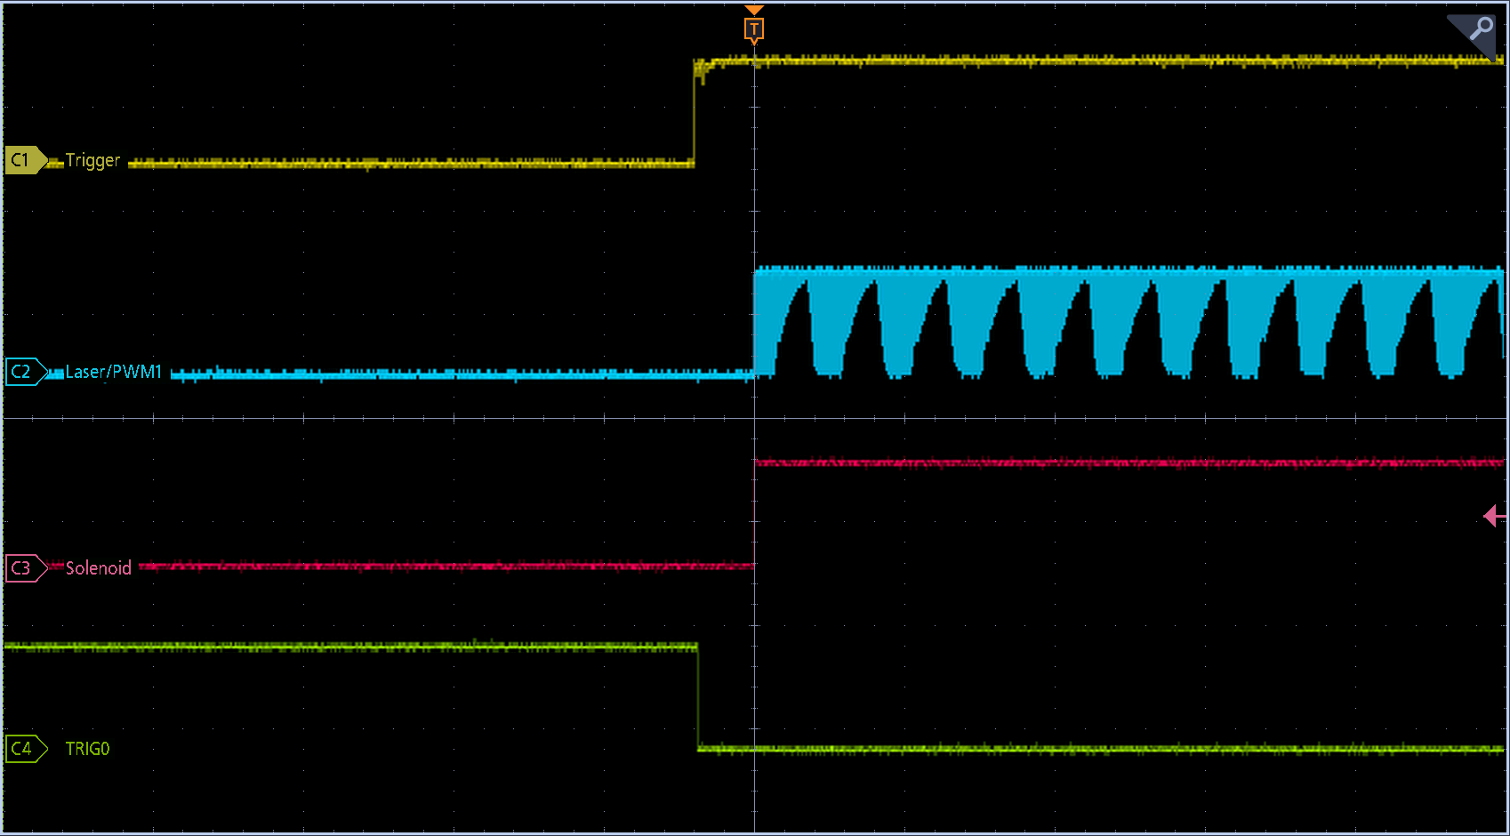

Slide 7
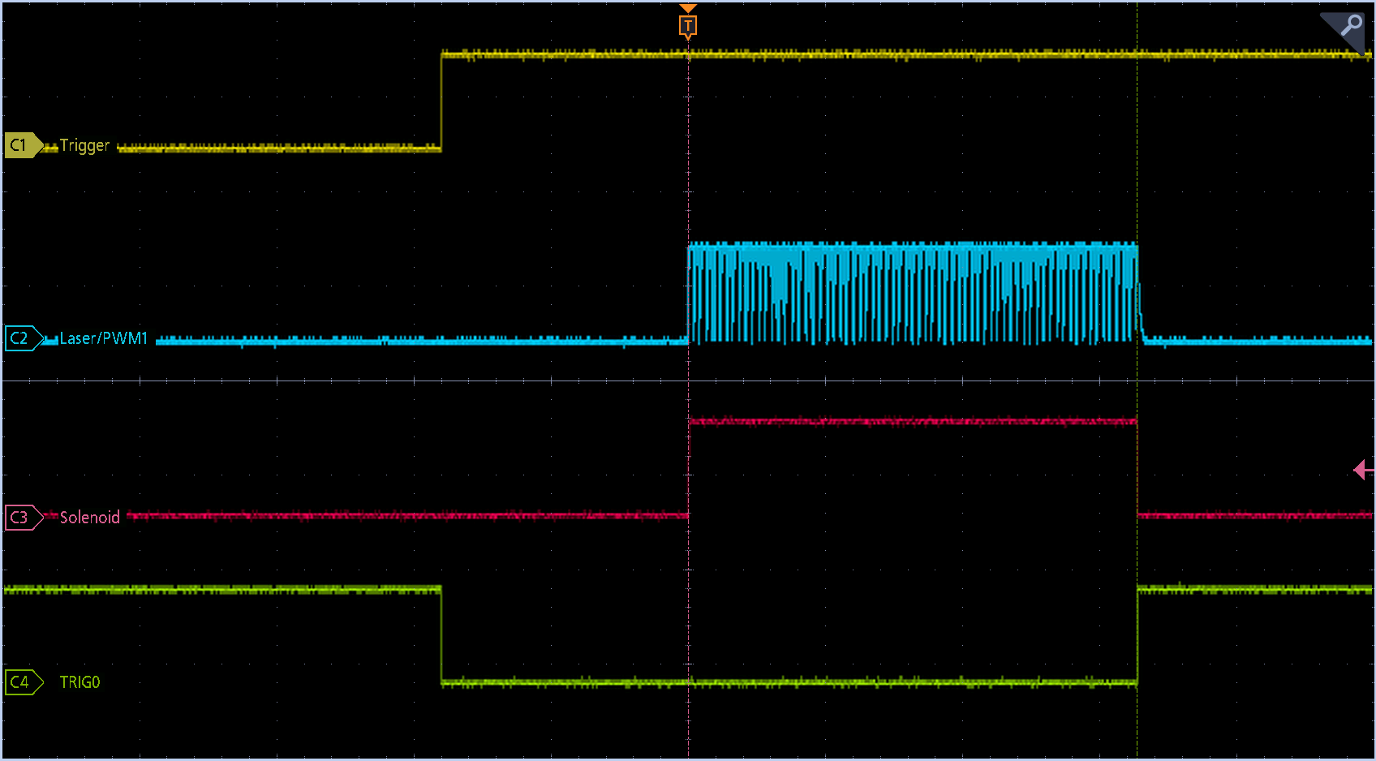

Slide 8
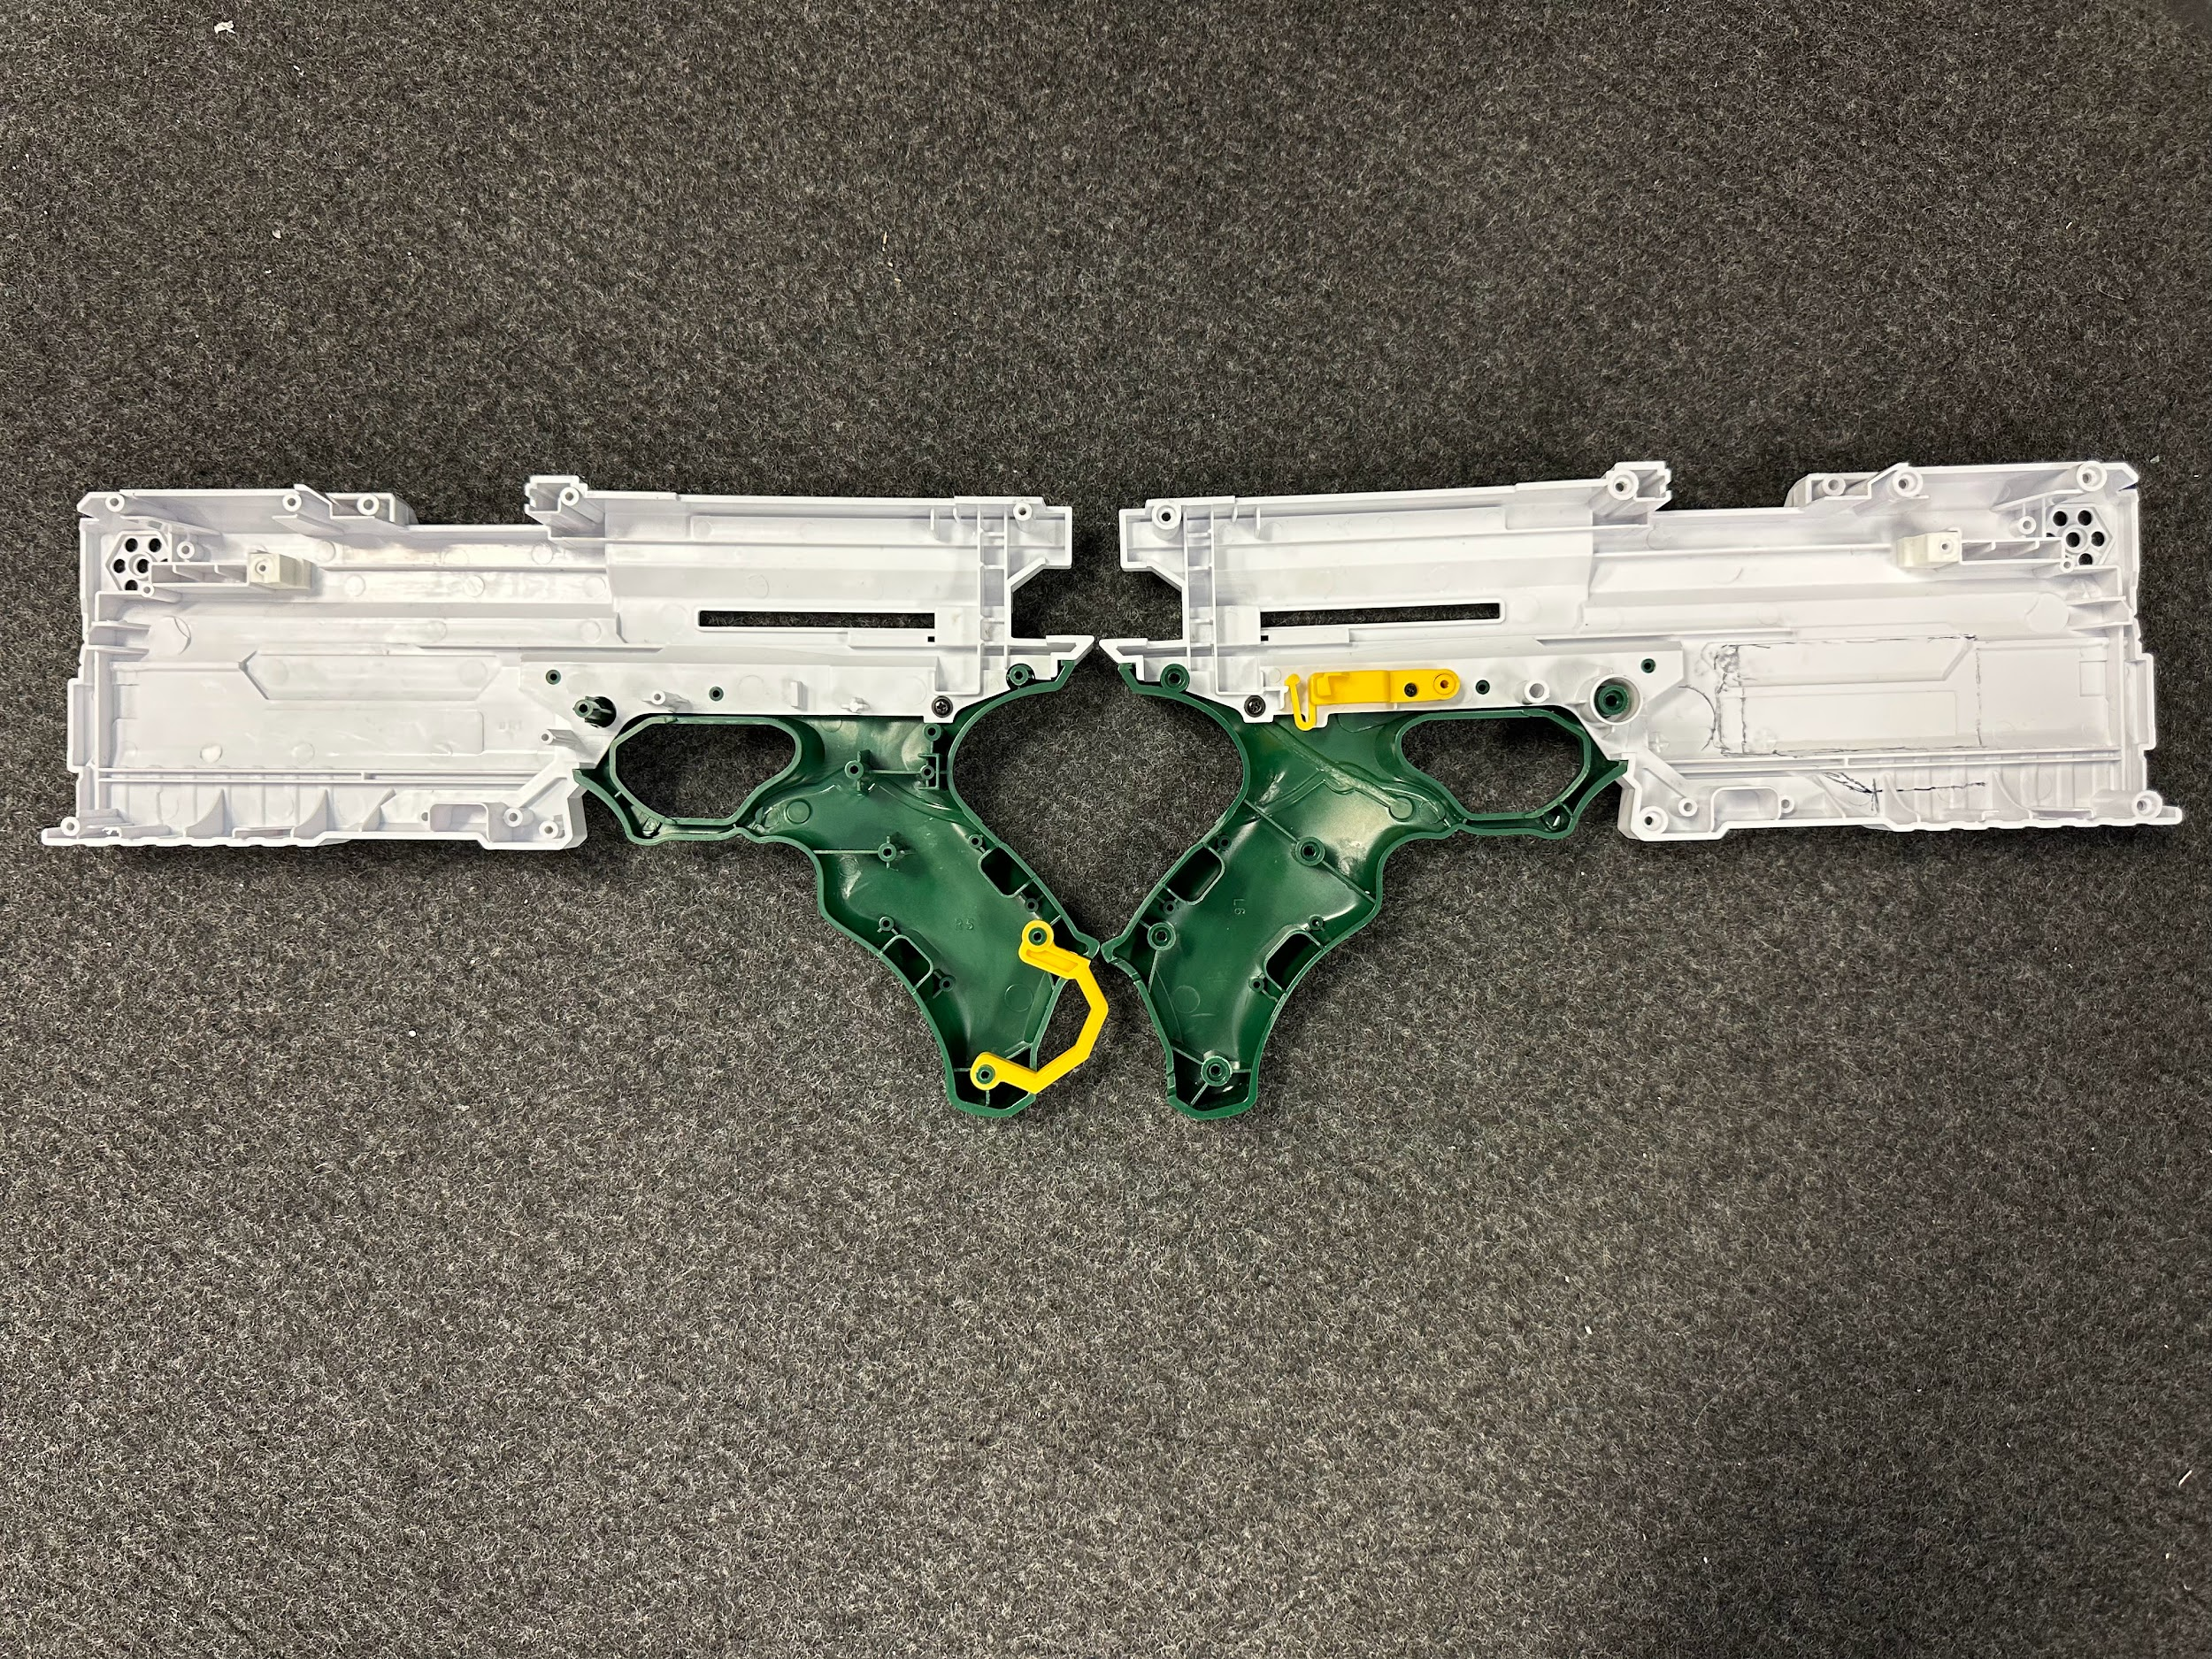
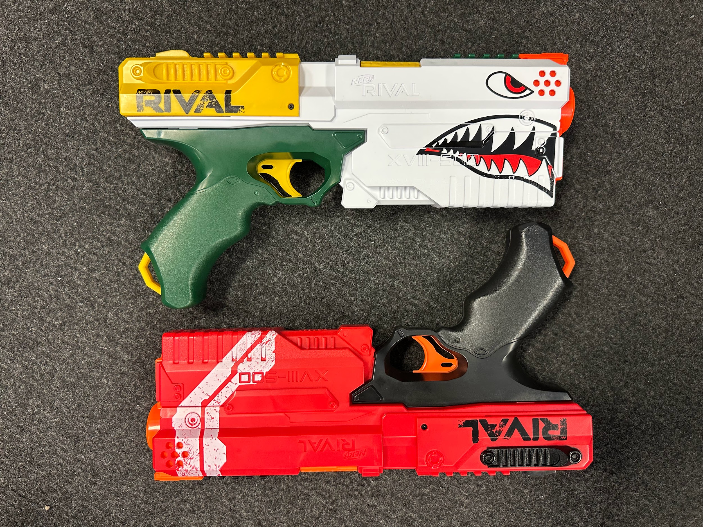

Slide 9
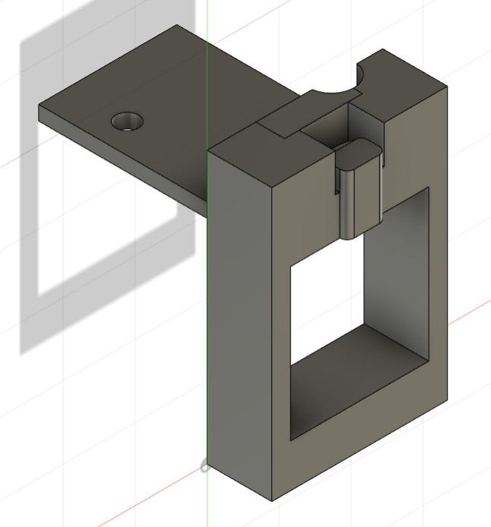
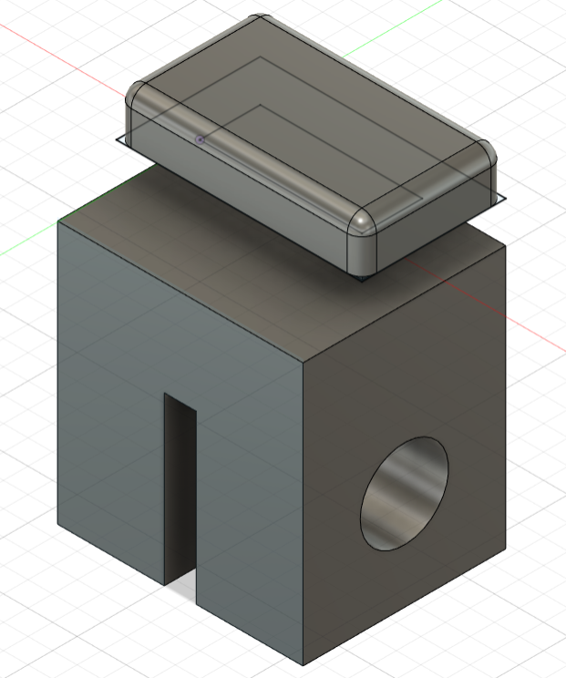
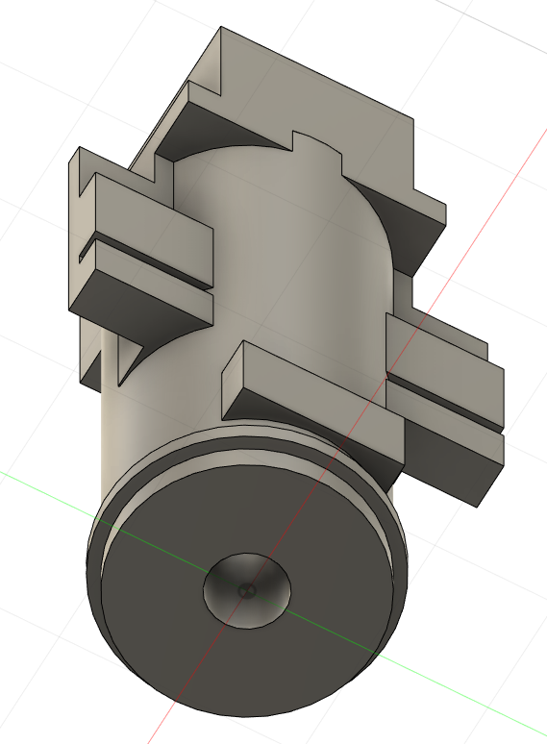
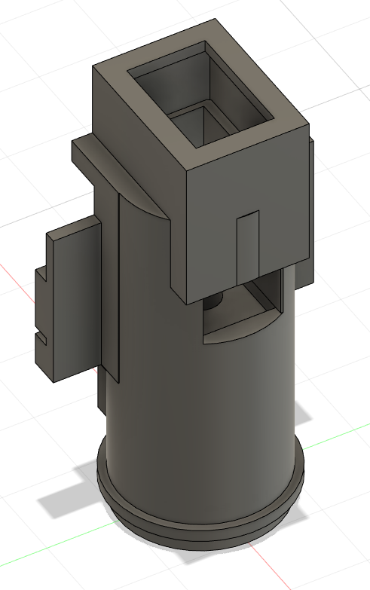
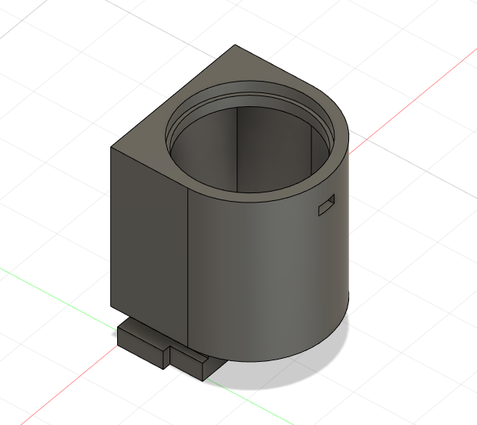
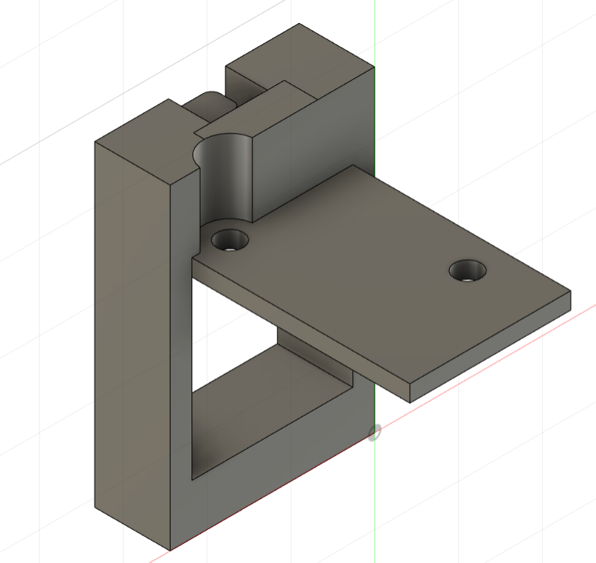
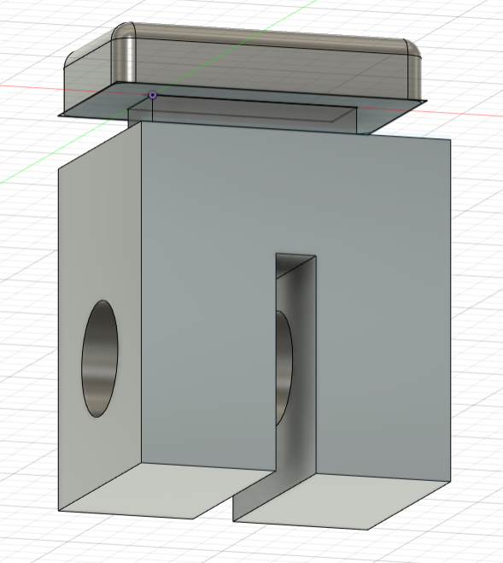
Blaster Mechanical Components

Slide 10
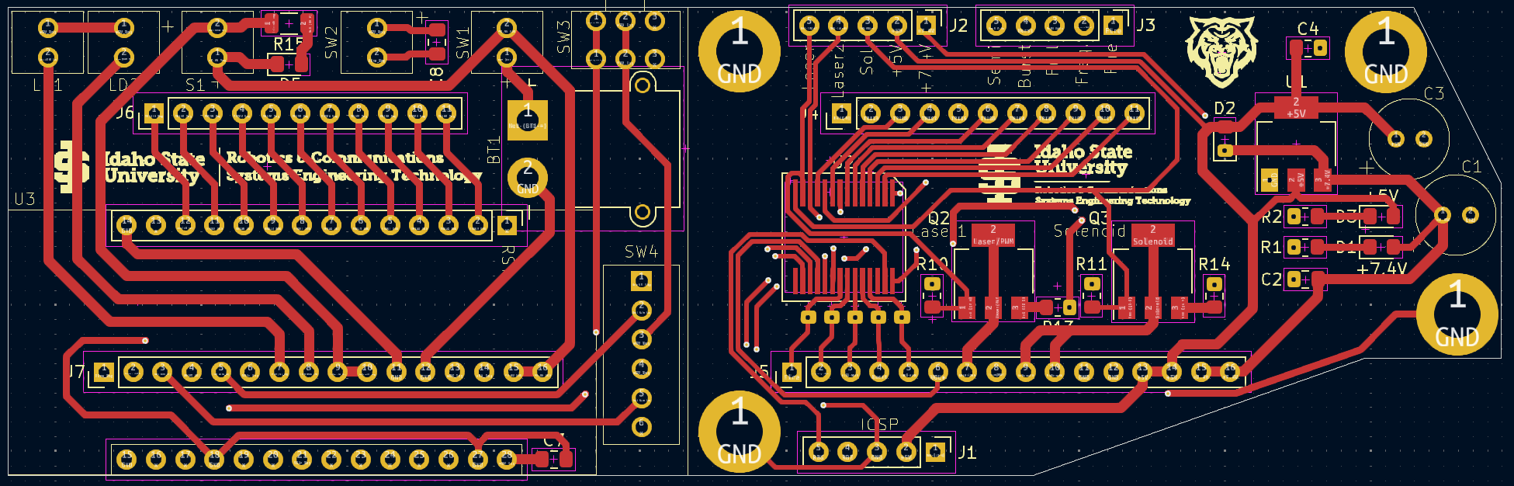
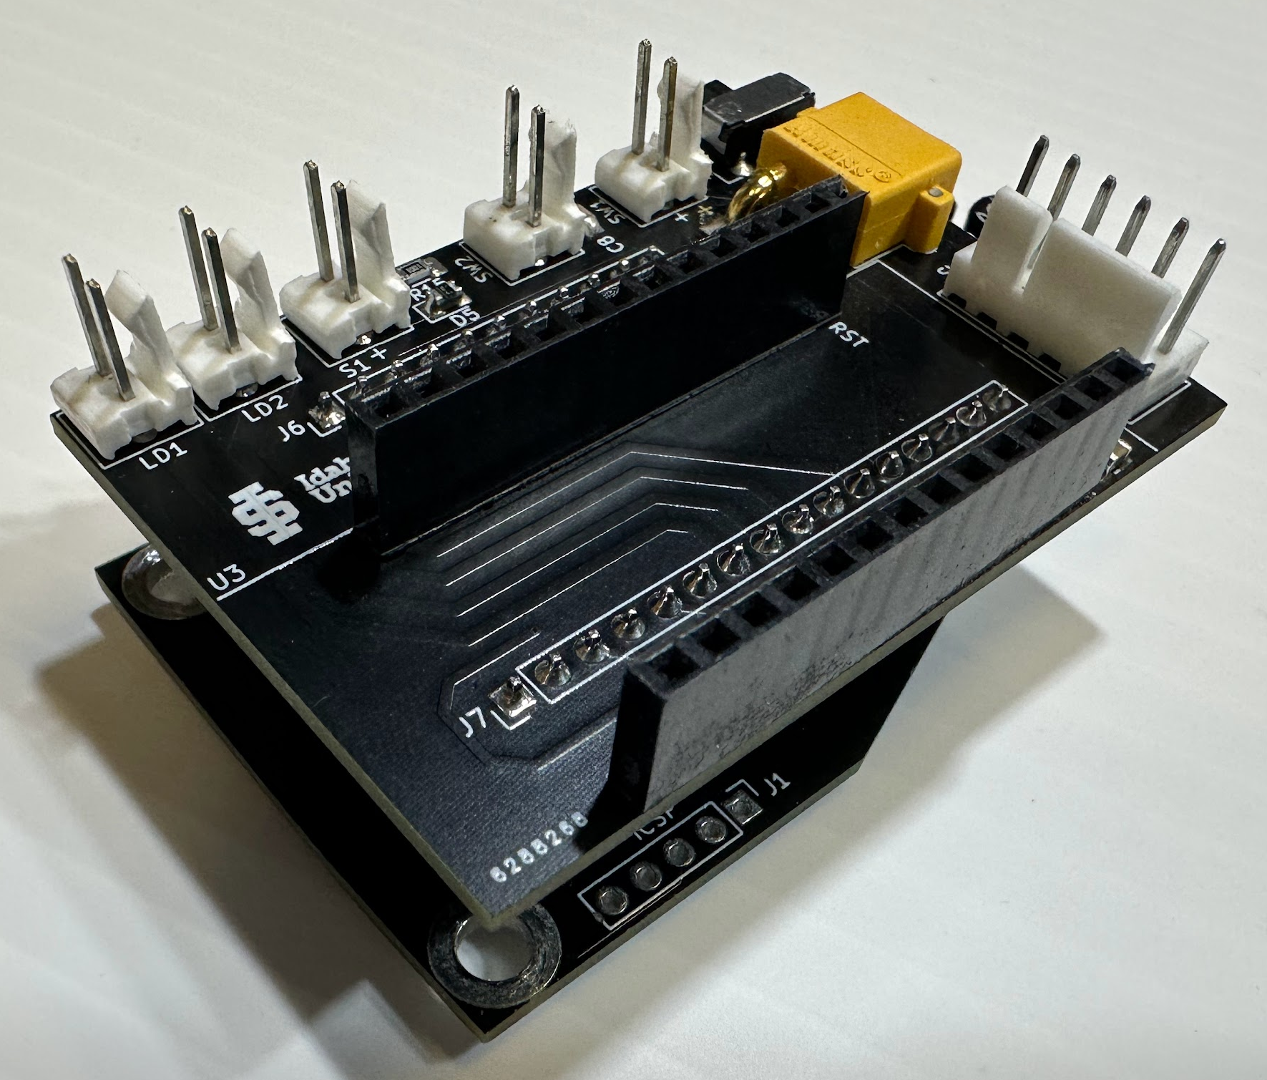
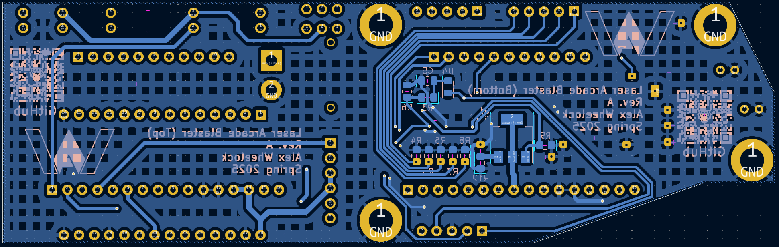
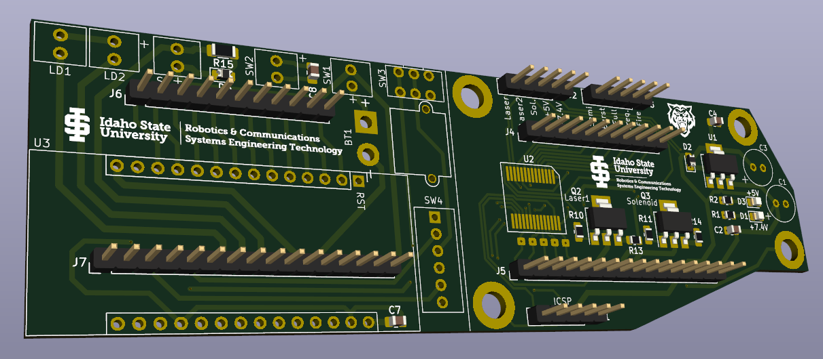
Blaster PCB

Slide 11
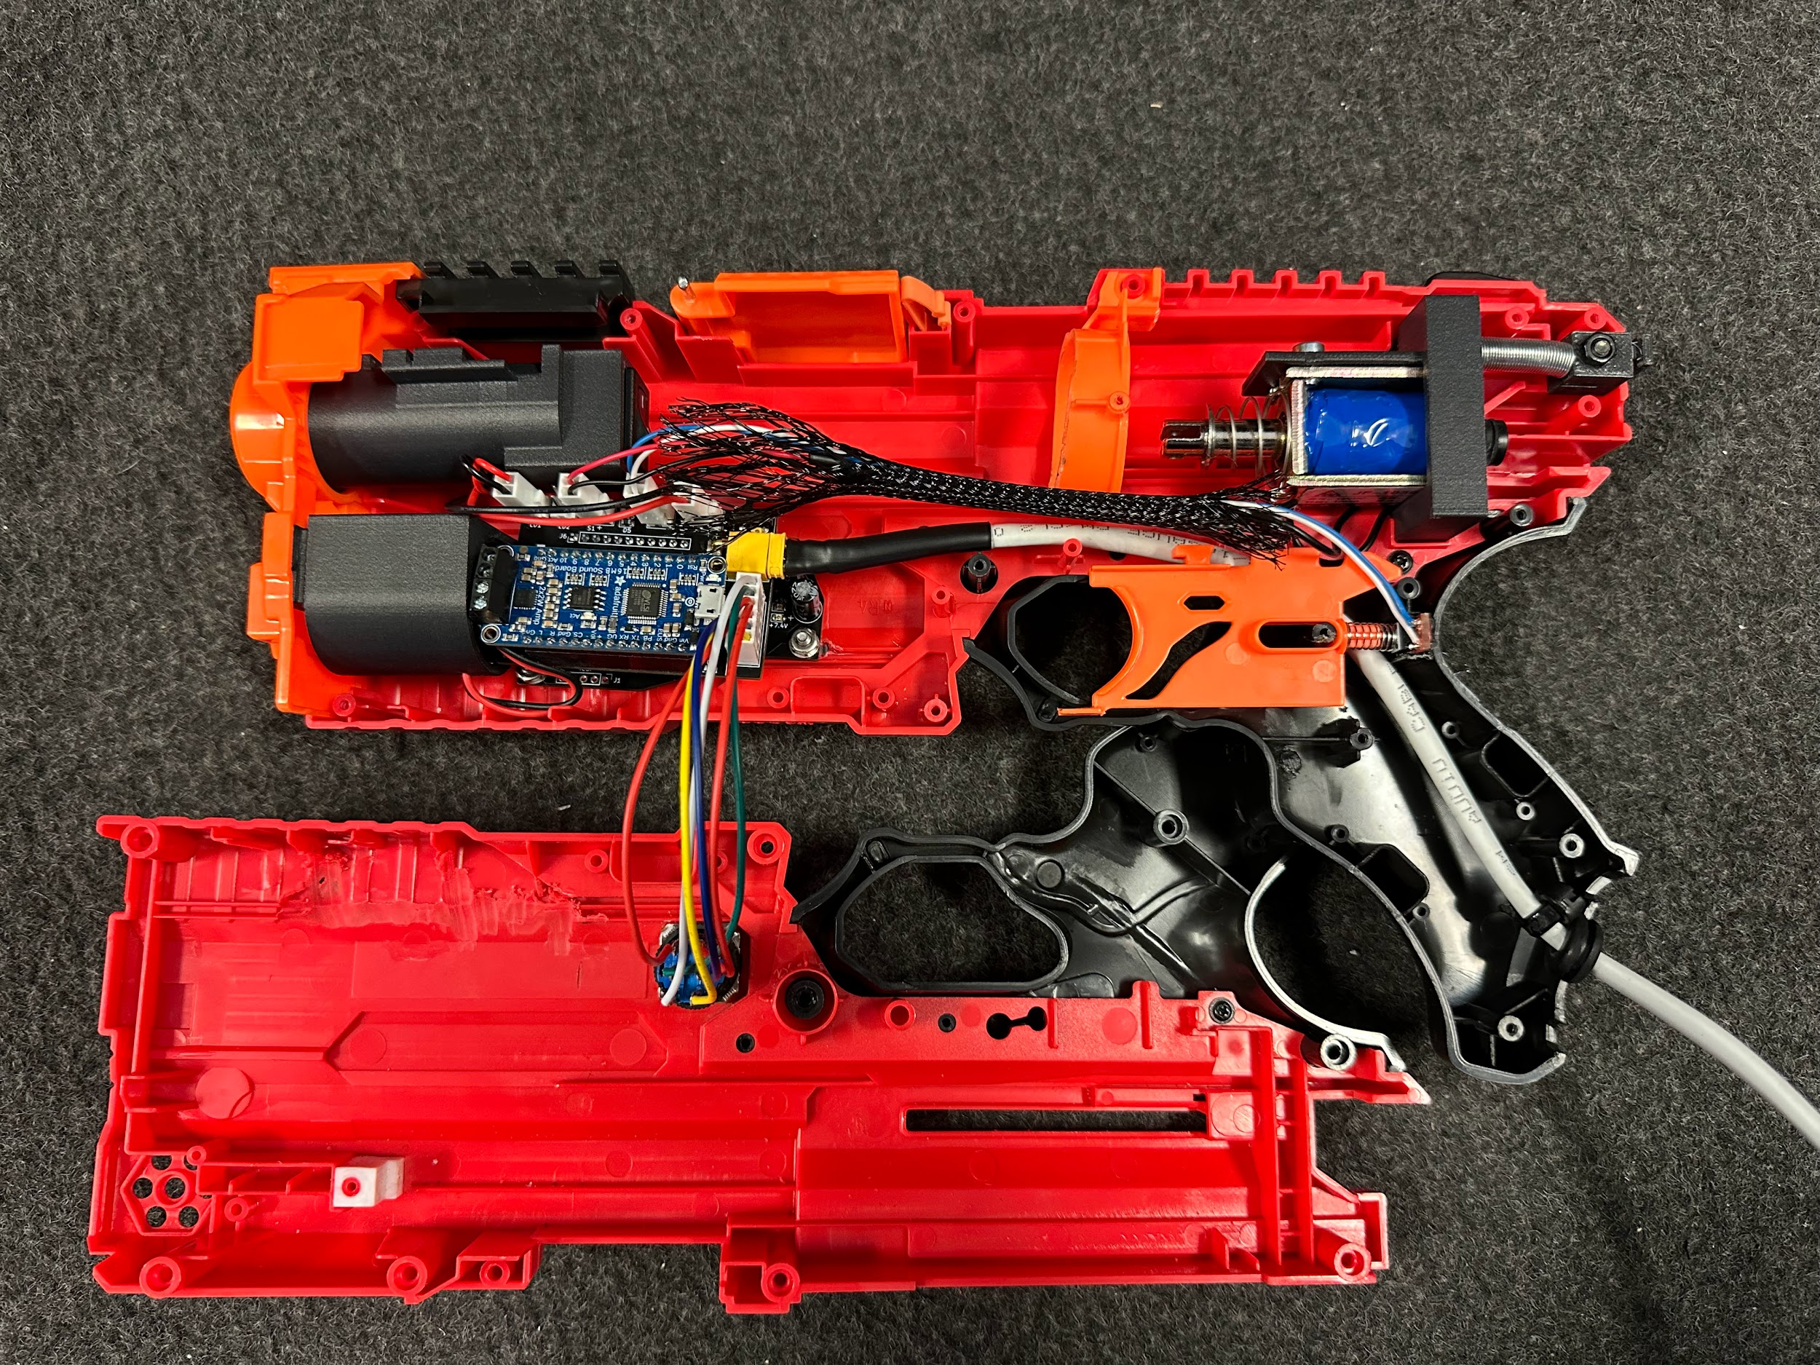
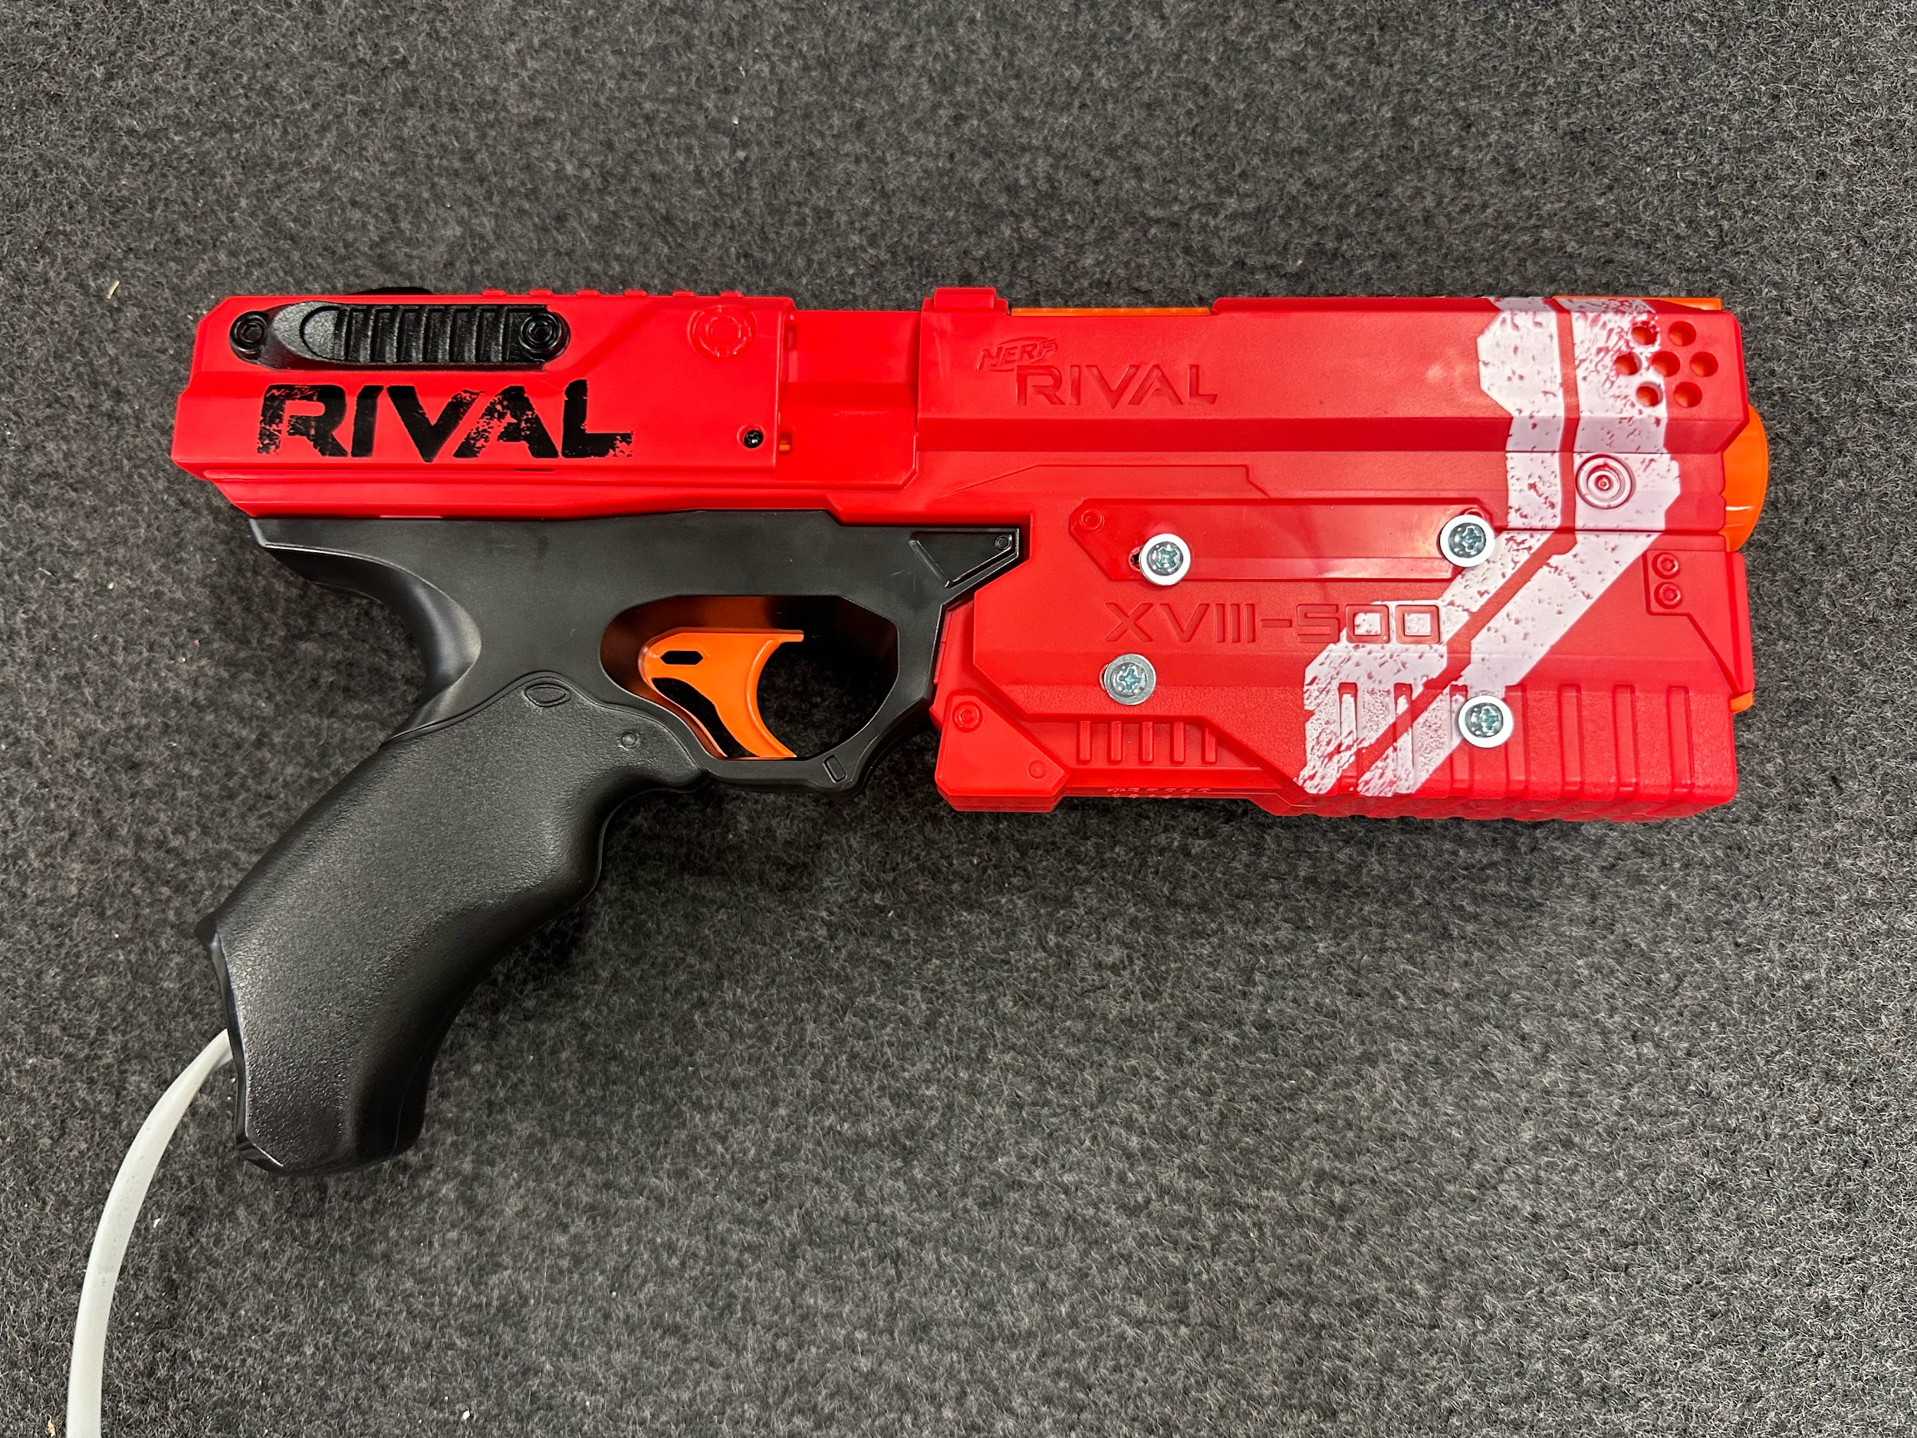
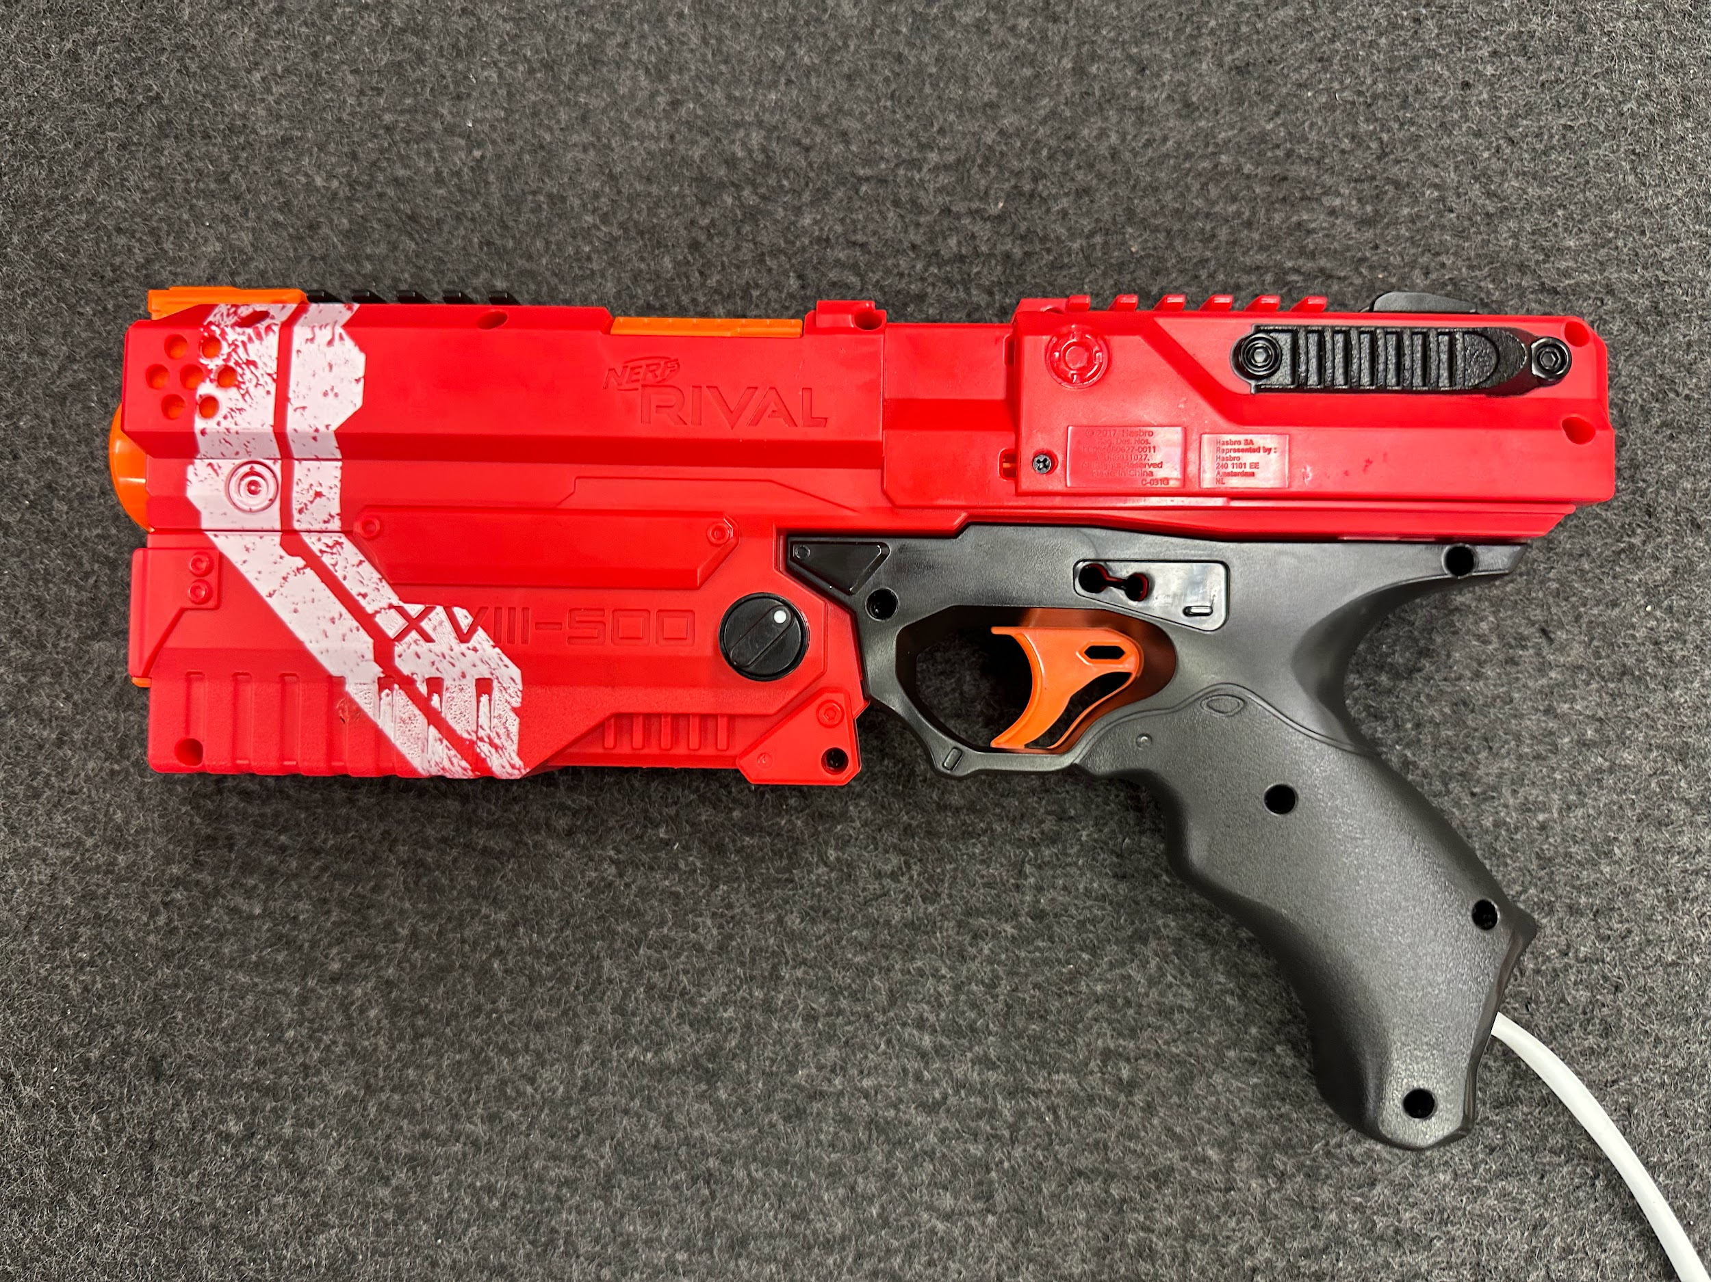
Blaster Final Build

Slide 12
Target System
Finalized and tested schematics
Support for more than one target
Up to 8 targets enabled simultaneously
Added UART communications
Created a Visual Basic program to control the arcade
Updated I2C Communications
Selectable slave addresses
Enable and Disable targets

Slide 13
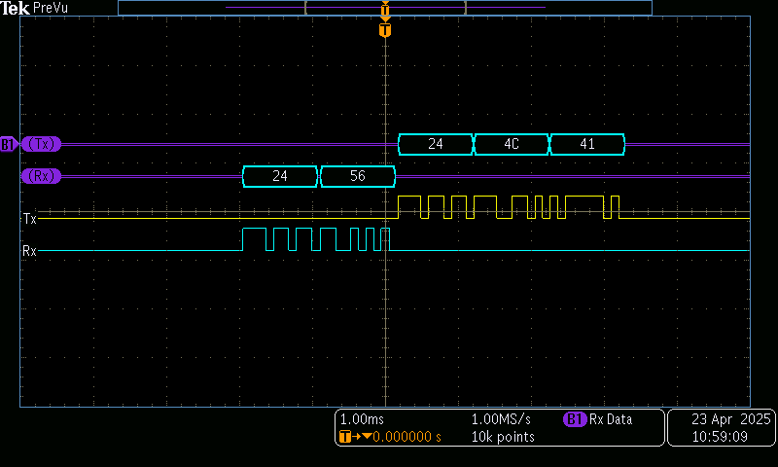
UART
Device Verification
Target Enable/Disable
Target address change

Slide 14
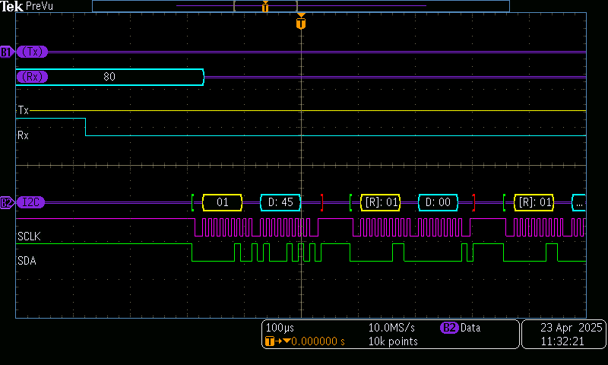
I2C
Updated Write Commands
Enable
Disable
Master polls all enabled targets via a I2C Read

Slide 15
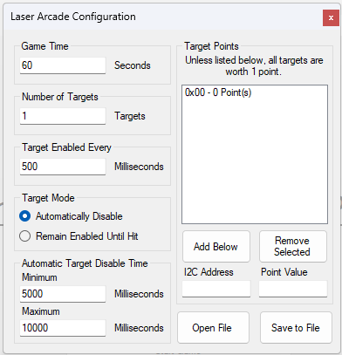
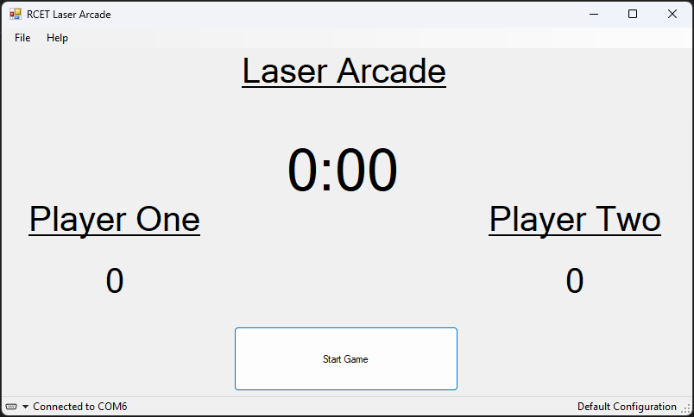
VB Program
Object Oriented Classes for controlling the Laser Arcade
GUIs for control and configuration
Ability to save and load configuration from file

Slide 16
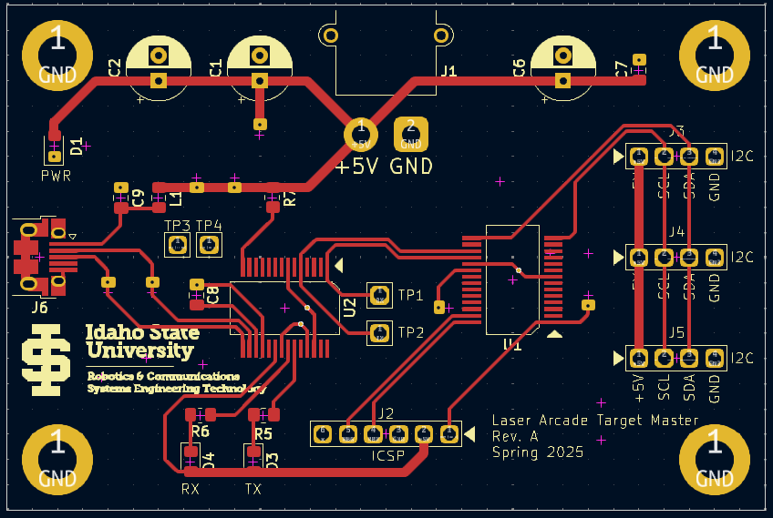
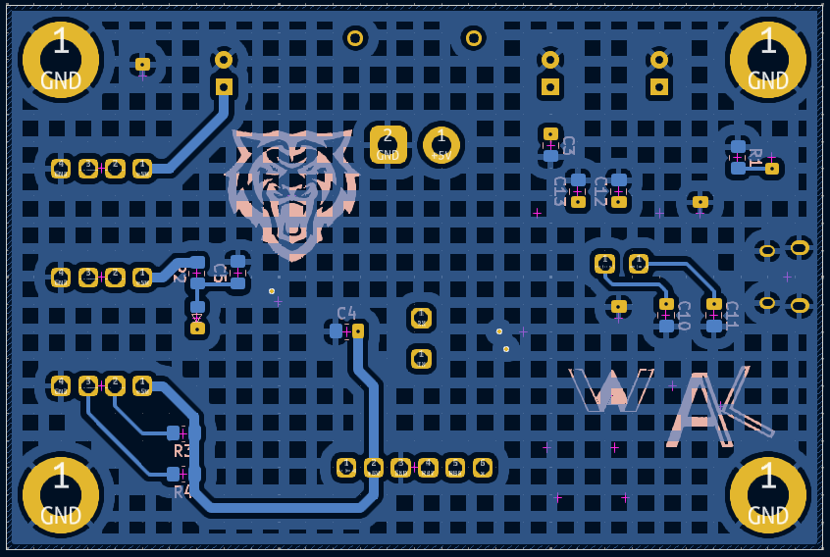
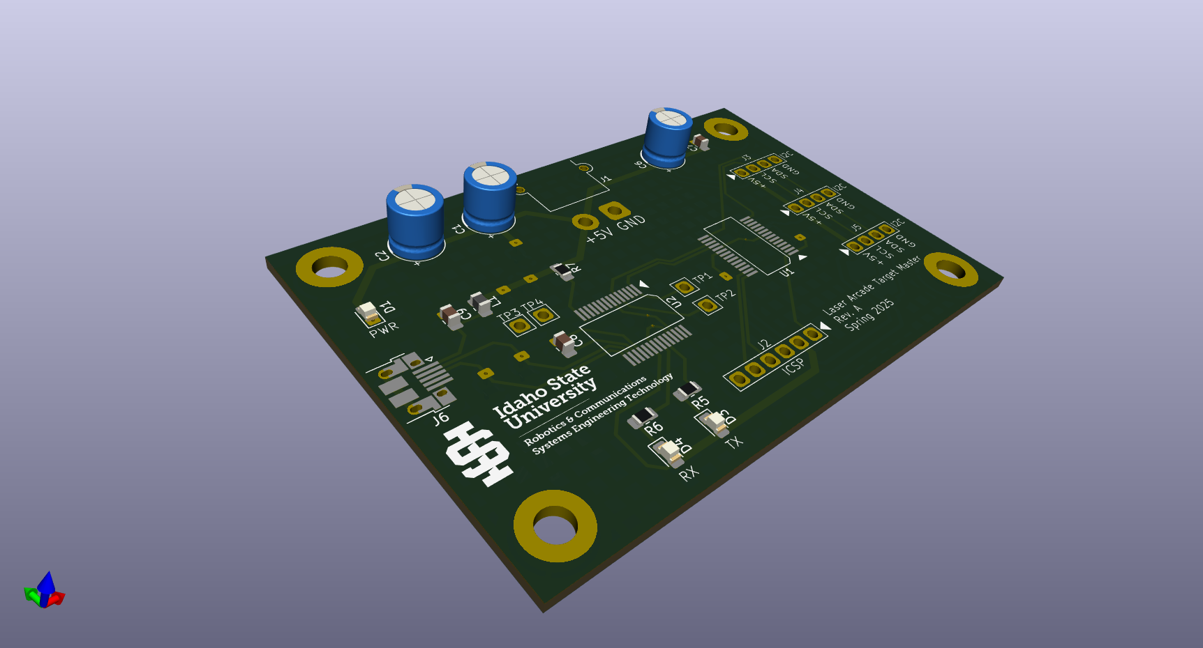
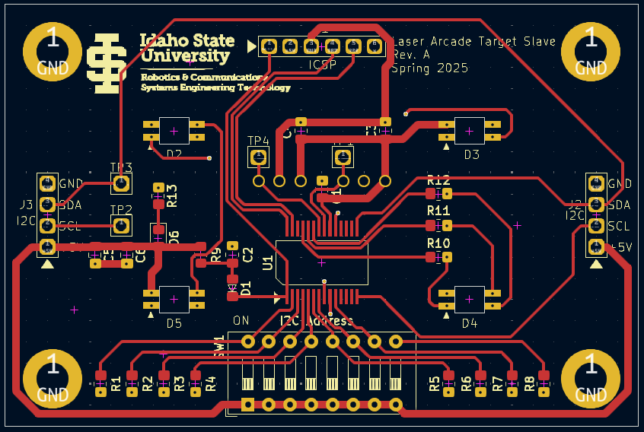
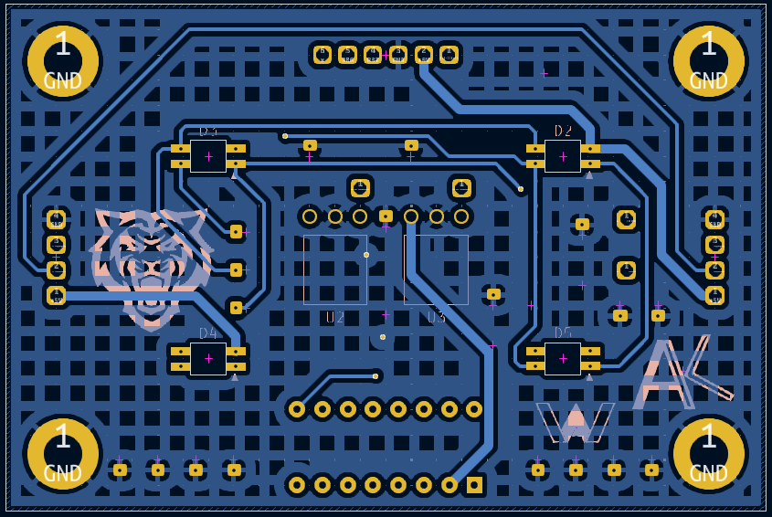
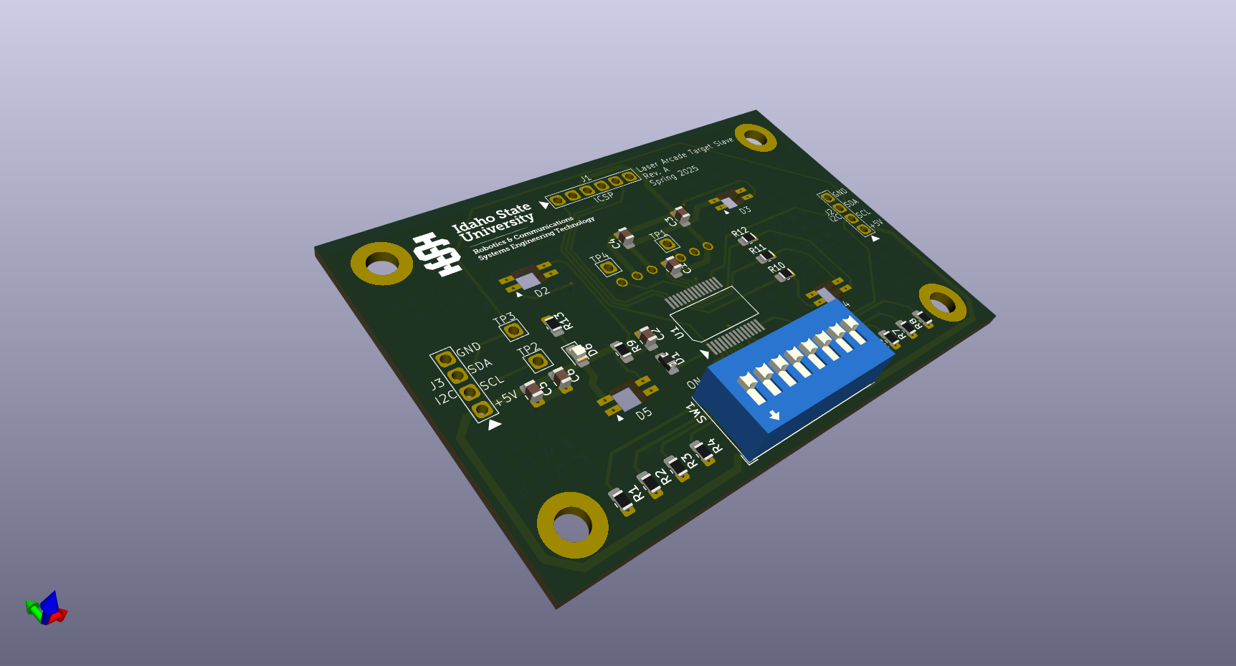
Target System PCBs

Slide 17
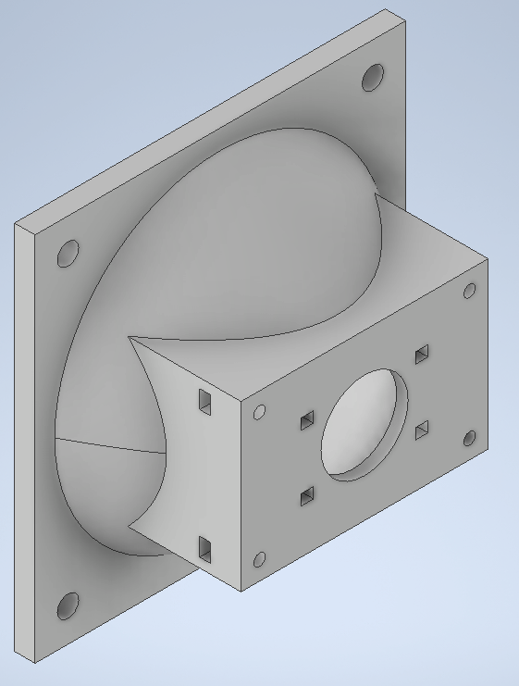
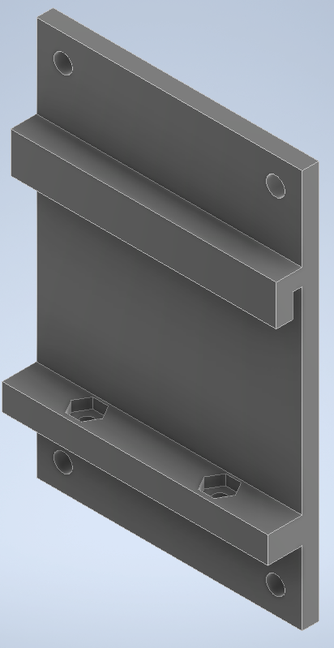
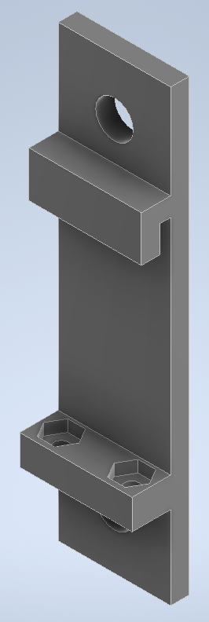
Target System Physical Components

Slide 18
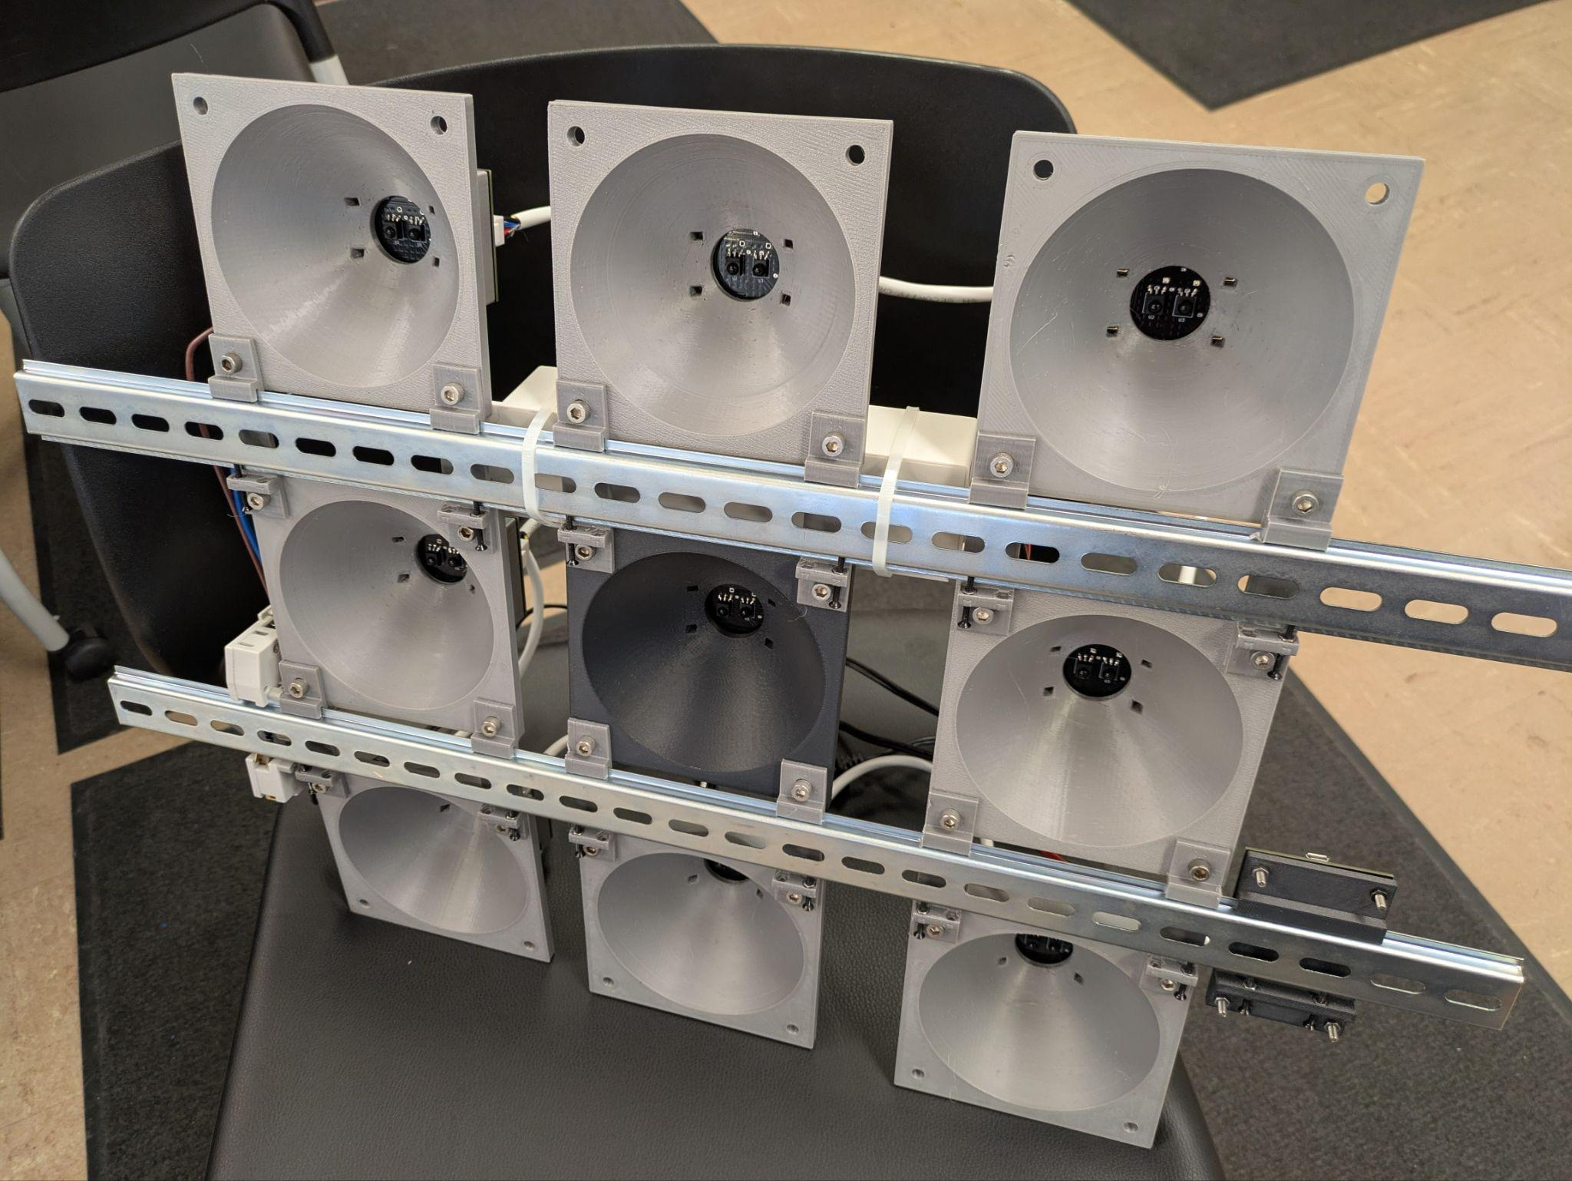
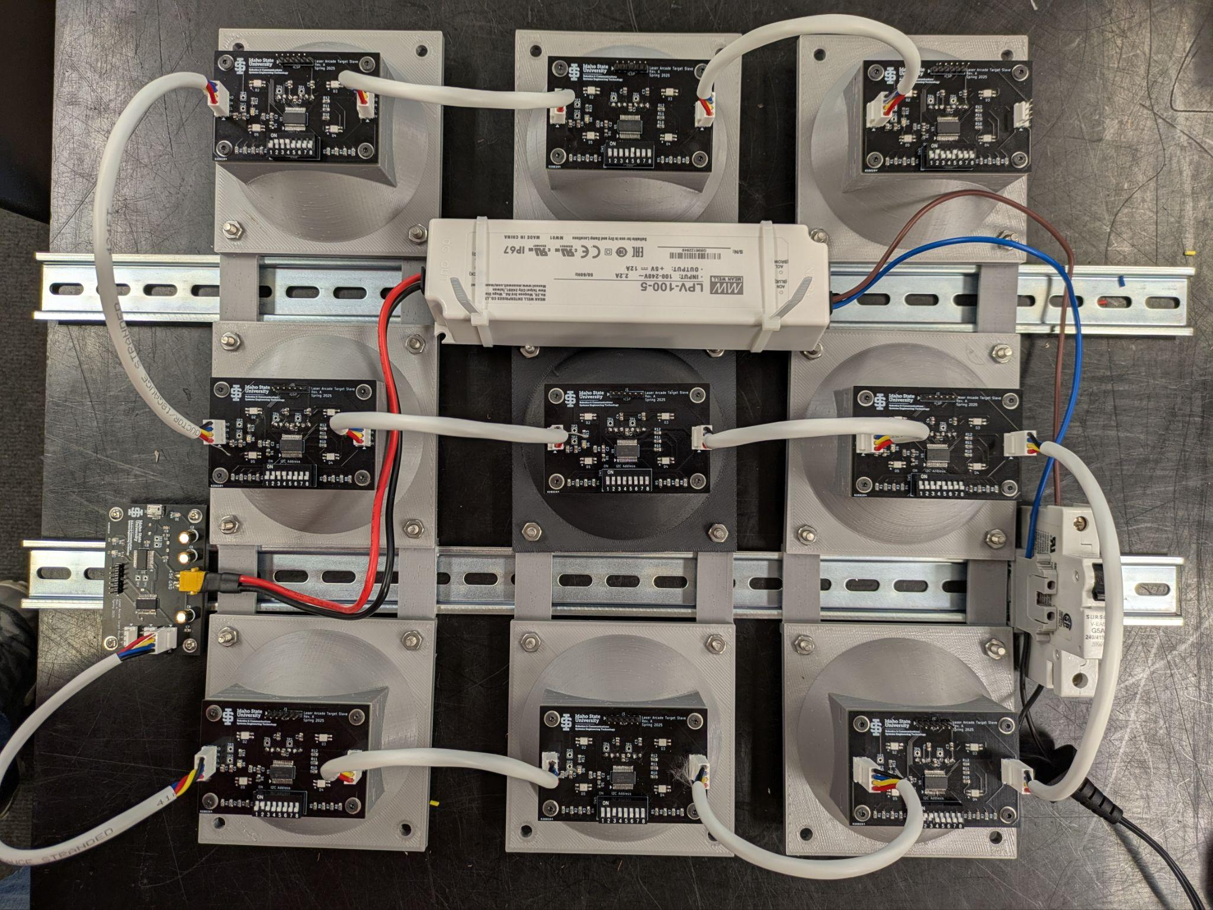
Target Final Build

Slide 19
Cost Analysis
 | Hours Worked | Cost ($50/hr)
Alex Wheelock | 128.83 | $6,441.50
Andrew Keller | 116.92 | $5,845.83
Total | 245.75 | $12,287.33
Labor | $12,287.33
Board Cost (2 Blasters) (1 Master) (9 Slaves) | $298.81
Total | $12,586.14
 | Board Cost
Blaster | $112.95
Master | $11.26
Slave | $6.85
Total | $131.06

Slide 20
Conclusion
There were high expectations regarding this semester’s goals for the Laser Arcade project, but all goals were achieved.
All schematics finalized, and PCBs designed.
A working target system was created and tested.
A working blaster was created and tested.
The biggest issue with the project’s current state is the IR sensors filter out visible light, not allowing the blaster’s laser to be seen by the target. An additional IR laser will be needed to consistently hit targets. As a result, the project is not currently in a working state.

Slide 21
Recommendations
Construct a second blaster.
Blaster needs to add an IR laser. Luckily a second laser output is present on the blaster. Current laser can be used for spotting, or a red dot optic can be used as well.
Design a custom blaster from scratch.
Code additional game modes into the VB program

Slide 22
Questions?

